Slide 1


SPARKLINES IN MS EXCEL
By Muhammad Umer Farooq(24k-0514)

Slide 2

The Purpose of Sparklines:
The purpose of Sparklines is to provide a quick, compact visual summary of data trends inside a single cell, helping users spot patterns, compare values, and understand information easily without creating large charts.

Slide 3
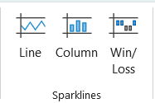
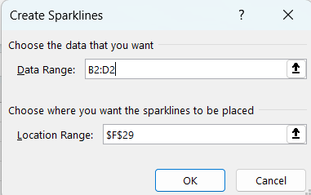

How to use Sparklines in Microsoft Excel:
To use Sparklines in Excel, select a cell where you want the Sparkline to appear, go to the Insert tab, choose the type of Sparkline, select the data range, and click OK to create the mini-chart.

Slide 4
Customization Options in Sparklines:
Change Sparkline: Switch between Line, Column, or Win/Loss.
Adjust Color: Customize the color of the lines or bars.
Highlight Data: Add markers for high points, low points, first, last, or negative values.
Change Style: Apply different Sparkline styles and themes for a professional look.
Group/ Ungroup Sparklines: Manage multiple Sparklines together or separately.

Slide 5

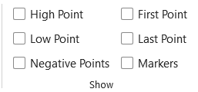
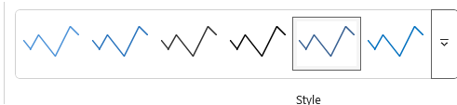
How to Customize Sparklines:
Click on the Sparkline you want to customize.
1
Use the Sparkline Tools tab that appears.
2
Choose options like Marker Color, Sparkline Color, or Style.
3
Highlight important points by turning on options like High Point or Negative Point.
4
Easily change design to match your report or presentation style.

Slide 6

Benefits of Using Sparklines:
Quick Visualization: Understand trends instantly without large charts.
Saves Space: Fits inside a single cell, keeping the sheet clean and organized.
Dynamic Updates: Automatically updates when the data changes.
Professional Appearance: Makes reports and presentations look polished.
Easy to Use: Insert and customize Sparklines in just a few clicks.

Slide 7
Conclusion:
Sparklines are powerful, space-saving tools for visualizing data trends in Excel.
They provide a quick way to identify patterns and changes in your data.
With simple customization options, Sparklines can make your reports and presentations more professional and visually engaging.
I encourage you to try using Sparklines in your next Excel project to experience the difference!

